Slide 1
Sales Prediction Dataset Analysis
By Kaustav Kamakhi Patro

Slide 2
What the dataset reveals?

Slide 3
Sales Prediction dataset
The dataset provided contains information about the advertising expenditures of a company on various platforms (TV, Radio, newspapers) and the corresponding sales of a product
When carefully explored we can see dependence of sales figures on advertising medium.

Slide 4
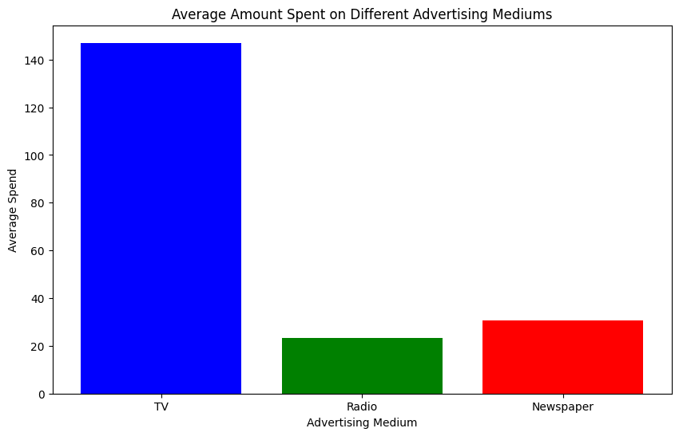
Analysis
Average spending on TV advertising is highest.
This is because TV advertising caters to a very wide range of audience

Slide 5
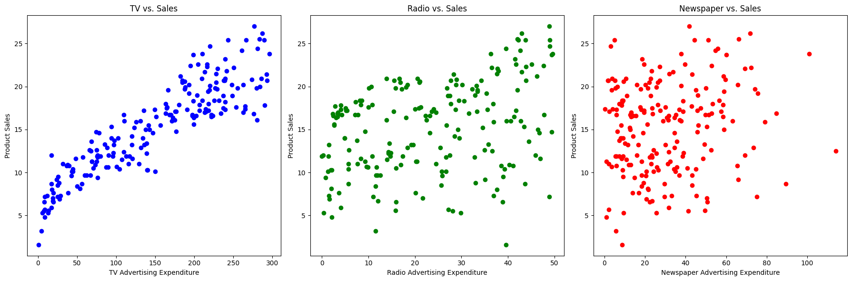
Analysis

Slide 6
Analysis
We can observe from the graph that as expenditure on TV ads increases sales also increases with it sharply. But in case of radio and newspaper it is not clearly evident.

Slide 7
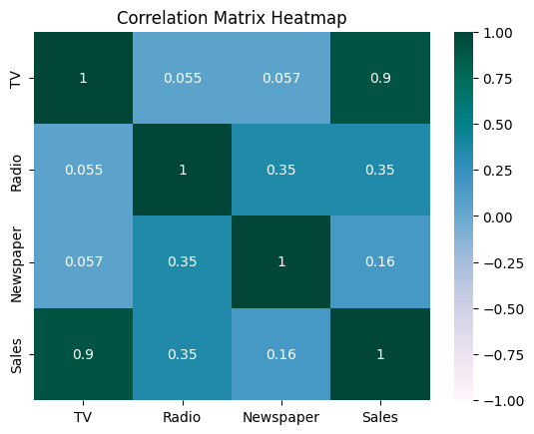
Analysis
The heatmap proves the statement that TV ad expenditure has strong correlation with sales

Slide 8
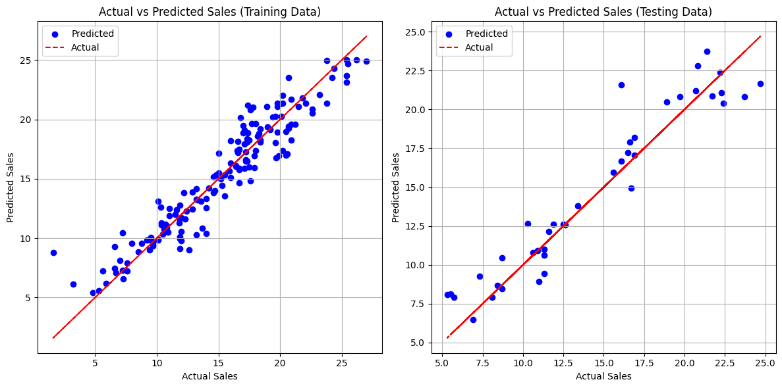
Analysis
The dataset was divided into training and testing sets. This was tested on additional data

Slide 9
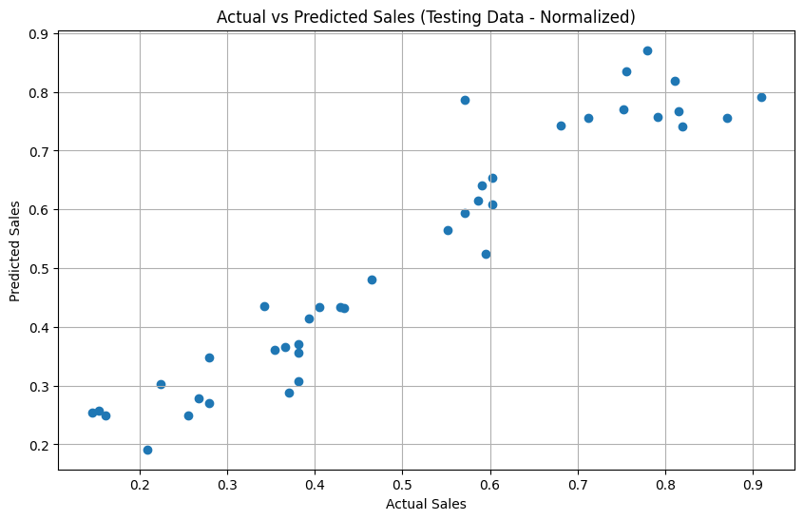
Analysis
But when the dataset was normalized results were more accurate with a lesser mean squared error value

Slide 10
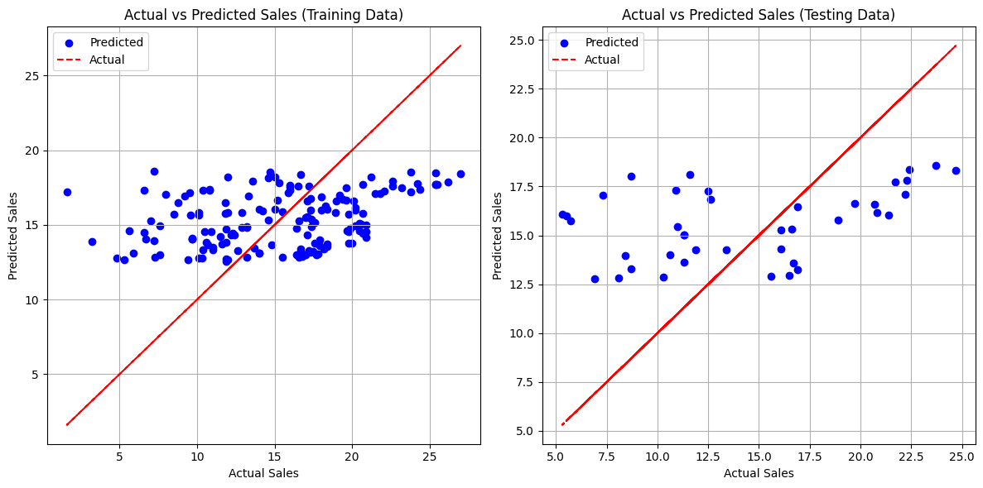
Analysis
When TV expenditure values are excluded from the model, sales prediction is impacted

Slide 11
THANK YOU

